Slide 1




DEPARTMENT ARTIFICIAL INTELLIGENCE AND MACHINE LEARNING
PROJECT PHASE II – REVIEW 1 PRESENTATION
SUSTAINABLE HERITAGE TOURISM IN INDIA: AGENTIC MULTI-AGENT AI FOR CONTEXT-AWARE, CARBON-MINIMIZED ITINERARY OPTIMIZATION
Batch Members :
1. HEENA MEHJABEEN K (221501043)
2. JAYA KARTHICK R (221501507)
3. YOGESWARAN S (221501511)
Under the Guidance Of
Dr.S.Poonkuzhali ,
Professor
Review I Date : 24ʳᵈ JAN 2026
1
Notes:
1

Slide 2

2
DOMAIN
Domain:
Artificial Intelligence
Sub-Domains:
• Multi-Agent Systems
• Intelligent Recommendation Systems
• Swarm Intelligence
• Optimization Algorithms
• Sustainable AI
Application Area:
Smart Tourism, Sustainable Travel Planning

Slide 3
INTRODUCTION
3
Tourists often struggle to balance convenience, cost, and environmental responsibility while planning their trips. The system addresses this by guiding travelers toward meaningful experiences that reduce environmental impact, support local communities, and ensure smoother crowd management across destinations. By encouraging travelers to explore responsibly, the system helps protect natural attractions, reduces strain on popular sites, and boosts lesser-known local areas. This creates a more enjoyable travel experience while promoting long-term sustainability for destinations.

Slide 4
4
MOTIVATION
High carbon emissions from travel – Needs eco-friendly planning.
Lack of smart, real-time itineraries – Most plans ignore crowds and sustainability.
Missed local eco friendly experiences – Tourists need better cultural immersion.
Need for responsible tourism – AI can guide smarter, greener travel.

Slide 5
LITERATURE REVIEW
5
Paper Title | Author & year | Methodology | Inference | limitations
Metaverse 3C framework Concept, Components, and Challenges in the travel and tourism domain | Poonkuzhali, 2023 | The study aimed to interpret the metaverse’s role in creating immersive virtual tourism experiences through technologies such as VR, AR, and blockchain. A conceptual and analytical methodology identified core technical components. | Results highlighted the framework’s capacity to enhance user immersion and interactivity, yet high infrastructural cost and interoperability issues limit adoption. | Prototype stage with limited field validation and depends on availability/quality of real-time context data (queues, sensor feeds)
Sentiment Classification of Indian Tourist Reviews Using Deep Learning Techniques | G. Ratnakanth and S. Poonkuzhali, 2023 | Sentiment Analysis accuracy was improved for multilingual tourism data through hybrid CNN-LSTM networks | The model produced higher classification precision compared to traditional text-based approaches. The study contributes to developing culturally adaptive models for tourism analytics. | Limited linguistic resources and data imbalance were observed; thus, the model lacked in resources
Indian Tourist Recommendation System Using Collaborative Filtering and Deep Autoencoder. | G.RatnaKanth and S.Poonkuzhal, 2023 | The approach extracted latent relations between visitors and destinations from historical datasets. Results revealed higher recommendation accuracy and adaptability to dynamic trends. | Results showed higher recommendation and adaptability to dynamic trends when compared with standard matrix factorization. | Cold-Start problems and sparse user data were constraints. It only offers regional tourism recommendations
Agent-Based Modelling for Sustainable Tourism | Stefanie Wallinger, 2022 | Survey + case studies demonstrating agent-based models (ABM) to simulate visitor flows, stakeholder behaviors, and policy interventions at destinations. | ABM is effective for exploring emergent crowding patterns and testing management interventions (time-slots, capacity limits, alternative routing). | ABM requires careful calibration and detailed local data; transferability between sites is limited without re-parameterization.
]survey on personalized itinerary recommendation: From optimisation to deep learning | Sajal Halder, 2023 | Systematic survey of POI/itinerary recommendation techniques — sequence modeling, constraint solving, hybrid knowledge-based + ML approaches. | Combining temporal user behavior models with constraint optimization yields the best balance between personalization and feasibility for itinerary generation. | Gaps remain in integrating real-time sustainability signals (carbon, congestion) and in end-to-end deployment case studies.

Slide 6
LITERATURE REVIEW
6
Paper Title | Author & Year | Methodology | Inference | Limitations
Enhancing tourism recommender systems for sustainable city trips using retrieval-augmented generation | Ashmi Banerjee, 2024 | Augments Retrieval-Augmented Generation (RAG) pipelines and reranking with a sustainability metric (Sustainability-Augmented Reranking, SAR) to bias LLM recommendations toward low-impact choices. | LLMs can be steered to recommend more sustainable options when the retrieval/reranking stage encodes explicit sustainability features, improving both relevance and eco-alignment. | Sustainability metric design is context sensitive; LLM outputs require verification to avoid factual errors and greenwashing.
Personalized tourism recommendation model based on temporal multilayer sequential neural network | XueFei Xiao, 2024 | Proposed TMS-Net that segments tourist trajectories and models temporal patterns for personalized route recommendation, validated on large trajectory datasets. | Temporal multilayer models improve route personalization and handle long spatiotemporal spans, which is critical for realistic itinerary planning. | Focuses on personalization/accuracy; does not explicitly model carbon emissions or real-time congestion in the base formulation.
Recommender systems for sustainability: overview and research issues | Alexander Felfernig, 2024 | Comprehensive review of RS approaches applied to sustainability problems across domains, identifying techniques (XAI, constraint reasoning) and open issues. | RS can be repurposed to promote sustainable choices but require explainability, multi-objective optimization, and domain-specific sustainability indicators. | Broad scope; specific operational recipes for tourism (carbon accounting, crowd control) require further applied research.
High-Frequency Tourist Flow Forecasting with Gated Recurrent Units and Attention Mechanisms | Changlong Wang, 2025 | Uses high-frequency time-series models (GRU/LSTM variants) to predict short-term tourist flows at POIs, enabling near-real-time crowd management. | Accurate high-frequency forecasting materially helps operational crowd control and can feed planners/agents for congestion-aware routing. | Requires continuous, high-quality sensor or visitation data; performance drops if data gaps or seasonality shifts are severe.
Multi-agent deep reinforcement learning based real-time planning (route/bus scheduling) | Binglin Wu, 2023 | Multi-agent deep RL framework for real-time planning and routing with competing objectives (service level, cost); experiments on customized routing problems. | Multi-agent RL can coordinate decentralized planners to produce adaptive, near-optimal plans in dynamic environments — applicable to itinerary optimization under changing conditions. | High sample complexity and training cost; transfer from simulated environments to real world requires domain randomization and careful validation.

Slide 7
LITERATURE REVIEW
7
Paper Title | Author & Year | Methodology | Inference | Limitations
Tour: Recommending personalized itineraries for smart tourism | João Paulo Esper et al., 2025 | Itinerary recommendation integrated with Multi-access Edge Computing (MEC), optimizing POIs, preferences, and app constraints | Provides joint optimization of itineraries with resource awareness, suitable for real-time smart tourism apps | Focuses heavily on MEC resource allocation; limited validation in diverse tourism contexts
Modeling sustainable city trips: integrating emissions, popularity, and seasonality into tourism recommender systems | Ashmi Banerjee et al., 2024 | Builds a sustainability score combining emissions, popularity, and seasonality, tested in a recommender system | Shows how CO₂, demand, and popularity can be balanced in city trip planning | Evaluated only in urban tourism; does not address multi-day heritage itineraries
A User Interface Study on Sustainable City Trip Recommendations | A Banerjee el at ,2024 | User study evaluating how sustainability labels and popularity info affect traveler decisions | Demonstrates that clear sustainability cues increase eco-friendly travel choices | Limited to UI factors; backend optimization for carbon/crowd not addressed
Promoting sustainable tourism by recommending sequences of attractions with deep reinforcement learning | Anna Dalla Vecchia, 2023 | Applies DRL to generate sustainable itineraries considering context like time, weather, and congestion | Reinforcement learning effectively produces adaptive attraction sequences | High computation cost; requires extensive training data from real tourism scenarios
Multi-objective fuzzy tourist trip design problem with heterogeneous preferences and sustainable itineraries | J Ruiz-Meza,2021 | Uses fuzzy logic and multi-objective optimization to balance heterogeneous tourist preferences | Handles uncertainty in user interests and provides flexible itinerary recommendations | Complexity increases with number of tourists; not optimized for real-time systems

Slide 8
LITERATURE REVIEW
8
Paper Title | Author & Year | Methodology | Inference | Limitations
Tourism demand forecasting using stacking ensemble model with adaptive fuzzy combiner | S Cankurt., 2022 | Ensemble ML model combining time series, fuzzy logic, and adaptive weights for prediction | Provides accurate demand forecasts for tourist flows | Focused on demand forecasting only; does not connect forecasts to actual itineraries
Research on optimization of tourist attraction route planning through multiple big data | M Dong., 2024 | Combines POI data, road networks, and GA-PSO hybrid algorithm for route planning | Produces optimized travel routes based on big data patterns | Primarily emphasizes algorithmic optimization; lacks sustainability focus
A carbon aware ant colony system for the sustainable generalized traveling salesman problem | Marina Lin., 2025 | Modified Ant Colony Optimization to include a carbon objective (bi-objective optimization) and tested on generalized TSP routing tasks to minimize CO₂ while preserving route quality | Carbon-aware metaheuristics can produce travel routes that trade small increases in distance/time for substantial reductions in emissions, suitable for transport-aware itinerary planning. | Focuses on routing/vehicle emissions only; does not integrate user preferences, site crowding, or multimodal door-to-door emissions
Implementation of green tourism concept through a dynamic programming algorithm to select the best route of tourist travel | A Susanty, 2018 | Dynamic programming used to select routes minimizing CO₂ emissions | Offers eco-friendly route optimization framework | Simplistic assumptions; ignores dynamic crowd and weather conditions
Use of the Multi-Agent Paradigm in Sustainable Tourism | M Husáková., 2023 | Multi-agent modeling applied to simulate stakeholder interactions in tourism | Shows value of agent-based systems for sustainability decision-making | Theoretical; limited case studies for practical validation

Slide 9
RESEARCH GAP
9
No unified system combining personalization + sustainability + real-time adaptability
Absence of agentic multi-agent coordination in tourism platforms
Carbon emissions are rarely considered in itinerary optimization
Lack of eco-conscious and user-adaptive heritage tourism planning

Slide 10

PROBLEM STATEMENT
10
Rapid growth in heritage tourism in India is causing unsustainable pressure on popular sites like Rajasthan’s forts, Hampi, and Khajuraho
India ranks 4th globally in tourism-related carbon emissions due to high domestic travel demand.
Existing systems lack integration of real-time carbon data, seasonal visitor load, and adaptive behavior modeling.
Current recommendation tools fail to provide personalized, eco-conscious travel planning.
There is a critical need for agentic AI-driven multi-agent systems to optimize itineraries while supporting conservation and community engagement.

Slide 11



11
OBJECTIVES
To create personalized user profiles and recommendations using Collaborative Filtering (SVD) and BERT embeddings for query encoding.
To build a sustainable tourism model by minimizing carbon emissions using the Carbon Emission Equation and multi-objective optimization (NSGA-II)
To generate optimized travel paths using Ant Colony Optimization (ACO) for efficient route discovery and iterative improvement..
To develop an Agentic model–driven multi-agent system supporting adaptive itinerary planning.

Slide 12
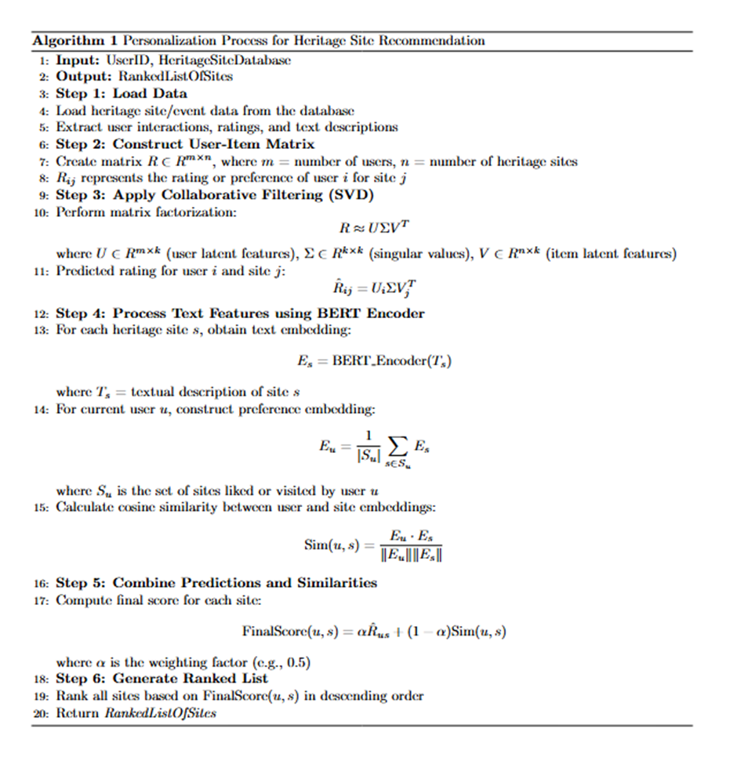
12
Pseudocode of Personalization Process for Heritage Site Recommendation

Slide 13
13
MODULES
MODULE-1: Web interface
MODULE-2: Personalization
MODULE-3: Sustainability and Impact Scoring
MODULE-4: Itinerary Optimization
MODULE-5: Planner agent

Slide 14

MODULE-1 : Web interface
14
Backend API
Data Validation & Preprocessing
Preference form
Authentication API
User via Web Interface
Database Storage Layer
PostgreSql
MongoDB
FireBase
Credential Verification
Fetch User Profile
Access Token Generation
User Dashboard
Return User Profile
The web interface enables users to log in, manage their profiles, and enter travel preferences or past trips.
User credentials are verified through an authentication API, and valid users receive secure access tokens.
Input data is validated and stored across PostgreSQL, MongoDB, and Firebase databases for structured, semi-structured, and real-time data.
When needed, the system fetches the combined user profile from these databases and passes it to the personalization model to generate tailored heritage site recommendations.

Slide 15
MODULE-2 :Personalization
15
Start
User Query +
Preferences
Input
Procesing
Collabrative
filtering
SVD
Decomposition
Latent Feature
Extraction
Candidate Heritage sites
Ranked Recommonedation list
Stop
send to sustainability model
BERT Embedding
Generation
RoBERTa/
DistillBERT
Contextual similairity scoring
Score fusion layer
The personalization module uses user queries and preferences to process input and apply collaborative filtering with SVD decomposition.
It extracts latent features and generates candidate heritage sites. RoBERTa or DistilBERT models create embeddings to measure contextual similarity.
A score fusion layer combines similarity and collaborative scores to produce a ranked list of heritage site recommendations, which is then sent to the sustainability model for final evaluation and personalized travel suggestions.

Slide 16

MODULE-3 :Sustainability and Impact Scoring
16
The sustainability module evaluates ranked heritage sites using extracted features like size and distance.
Multiple linear regression predicts each site’s impact, which is then analyzed using the TOPSIS multi-criteria decision-making method.
This process generates sustainability scores that measure environmental and social effects.
The final sustainability scores are passed to the itinerary optimization model to ensure travel plans promote eco-friendly and balanced tourism choices.
start
Ranked Heritage Sites
Data Preprocessing
Validation
Predicted impact scores
Multiple Linear Regression
Feature Extraction
Sustainability Scores
Multi Criteria Decision Making
Environmental
Sustainability Scores
Social
Economic
Output to itinerary optimization model
End

Slide 17
MODULE-4 : Itinerary Optimization
17
Start
Ranked Sites + Sustainability Scores
Graph Construction
Update Phermone Levels
Yes
Select Best Path
Optimized Itinerary JSON
STOP
No
Initialize Ant Colony Parameters
Find Optimal path based on Pheromone levels
Evaluate each path: Distance + Sustainability Score
This flow shows how the system creates an optimized travel plan. First, heritage sites are ranked based on distance and sustainability.
These sites form a graph where travel paths are tested using the Ant Colony Algorithm.
The algorithm repeatedly finds better routes by updating “pheromone” levels, similar to how ants find the shortest path.
Finally, it selects the route with the least distance and highest sustainability, generating the best possible itinerary in JSON format.

Slide 18
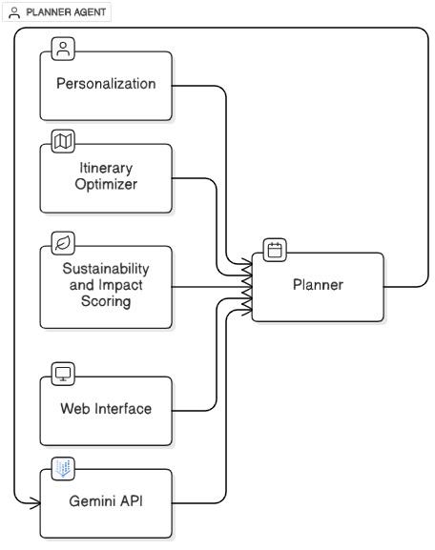
MODULE-5 :Planner agent
18
The Planner Agent acts as the central coordinator, combining insights from the Personalization, Sustainability, and Itinerary Optimization models.
It collects user data and preferences through the Web Interface, integrates ranked recommendations, sustainability scores, and optimized routes, and generates the final customized travel plan.
By orchestrating data from all modules, the Planner Agent ensures that the final itinerary is not only personalized and efficient but also environmentally sustainable and aligned with user expectations.

Slide 19
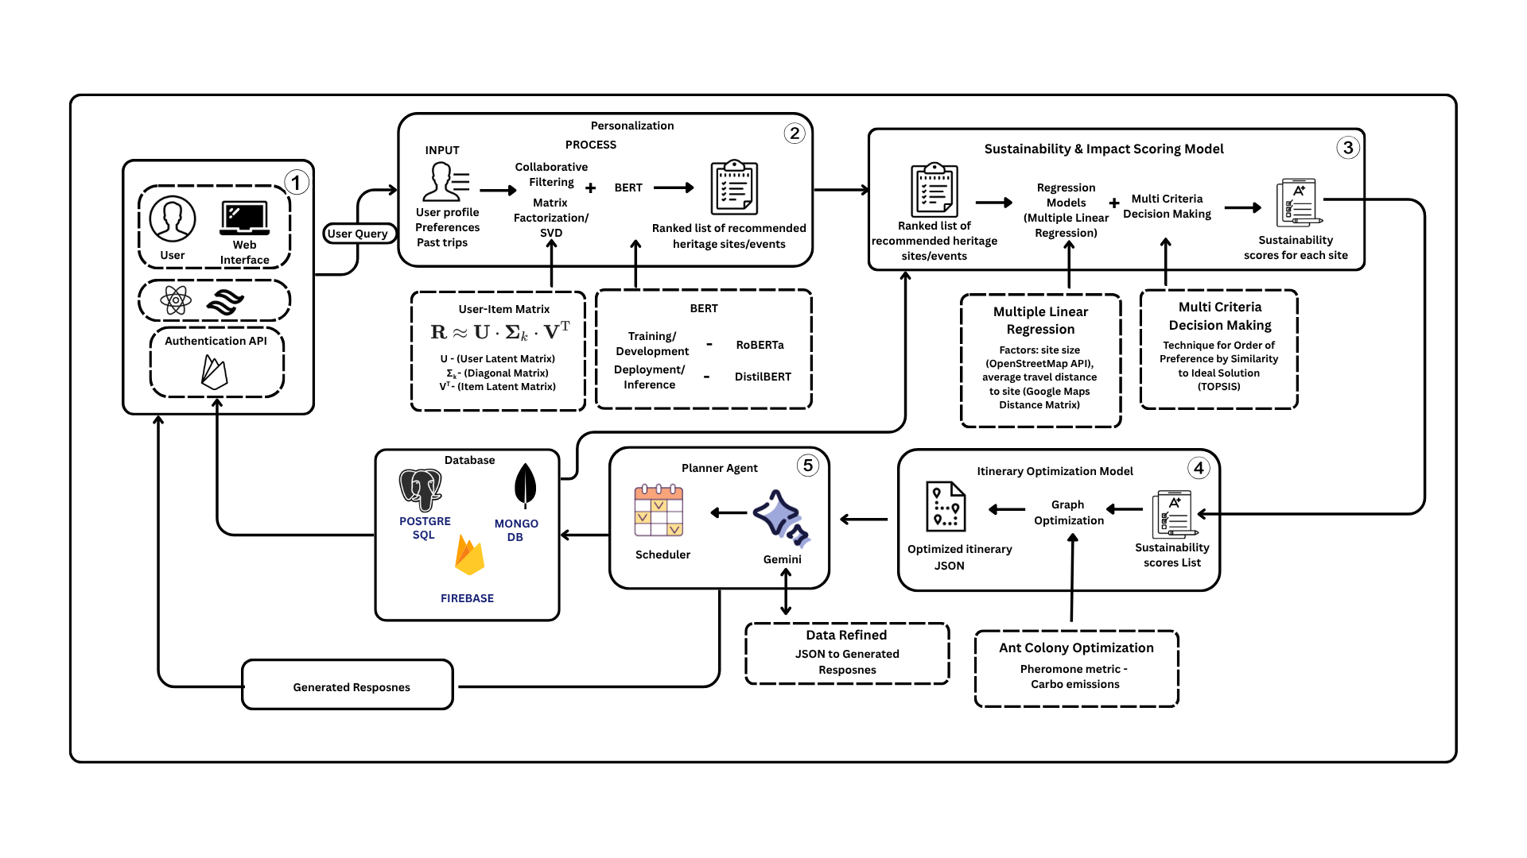
ARCHITECTURAL DESIGN
19

Slide 20
20
RESULTS AND DISCUSSIONS
The system generated personalized, sustainability-aware heritage recommendations that aligned well with diverse user preferences.
TOPSIS-based sustainability scoring successfully prioritized eco-friendly destinations without significantly reducing recommendation relevance.
Ant Colony Optimization minimized travel distance and carbon impact while maintaining itinerary feasibility and efficiency.
Multi-agent coordination enabled seamless integration of personalization, sustainability, and route optimization modules.

Slide 21
FUTURE ENHANCEMENTS
21
Integrate real-time data such as weather, traffic, and crowd density for dynamic itinerary adaptation.
Enhance multilingual itinerary generation by supporting more regional and international languages for broader inclusivity.
Incorporate reinforcement learning to enable continuous improvement of recommendations based on user feedback.
Add GPS-based mapping and live navigation to improve route accuracy and real-world travel feasibility.
Integrate local tourism services, accommodations, and guides to build a complete smart tourism ecosystem.

Slide 22
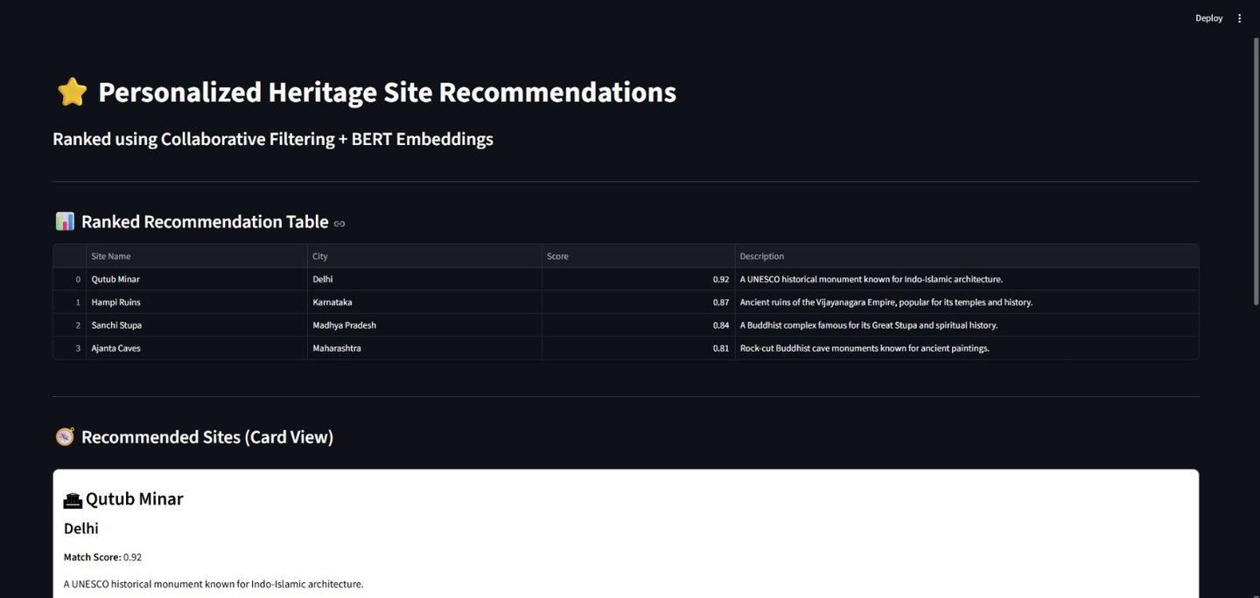
22
OUTPUTS

Slide 23
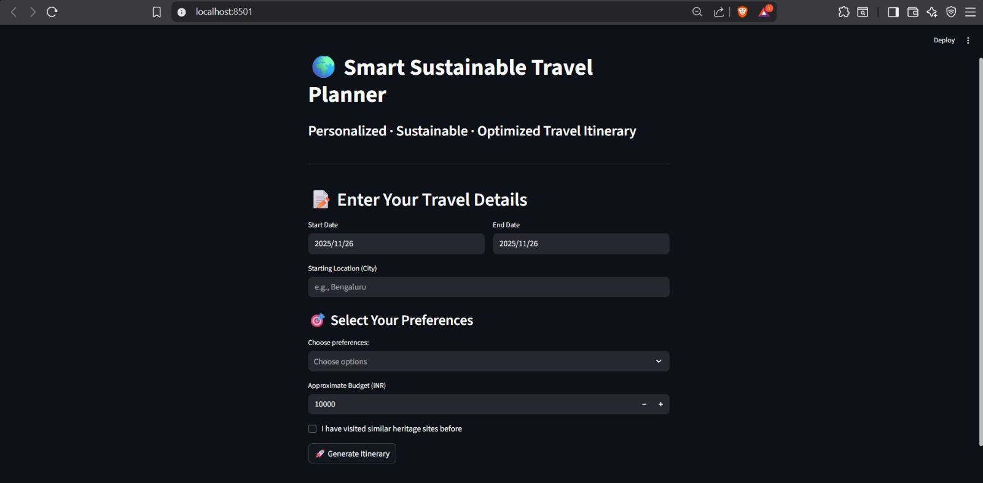
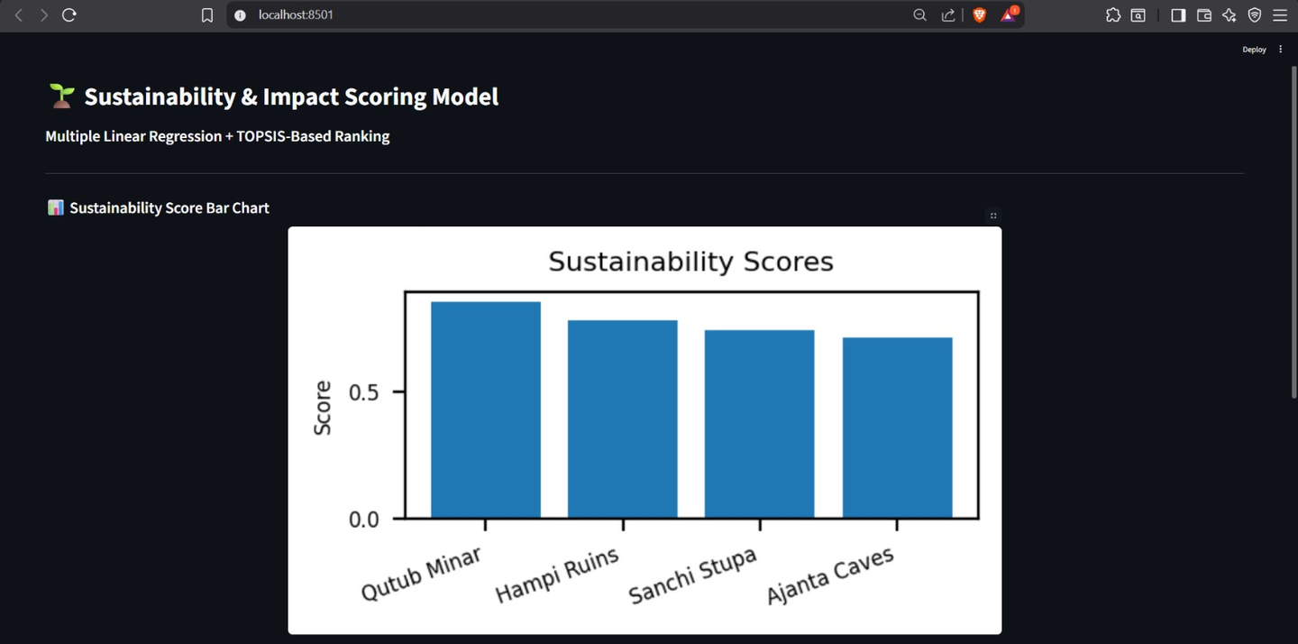
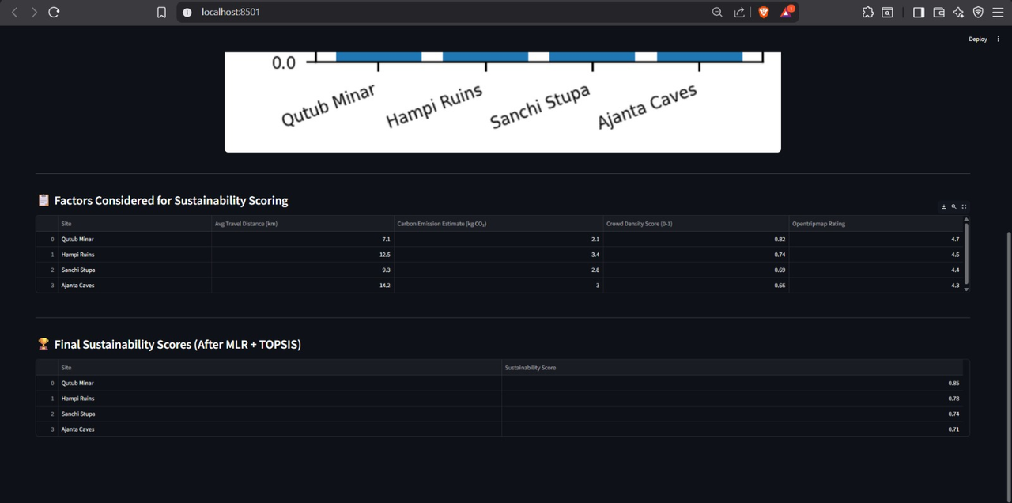
23

Slide 24
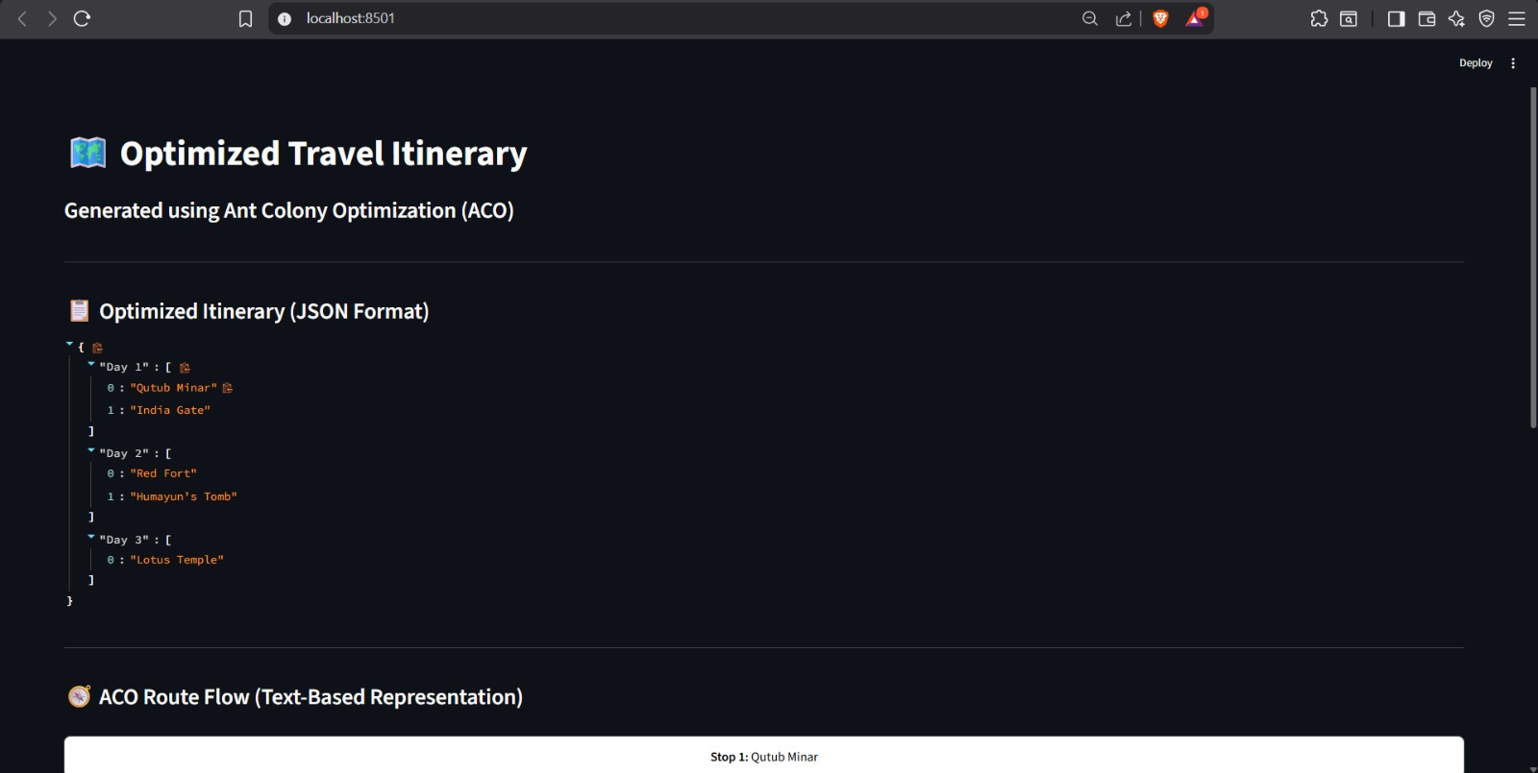
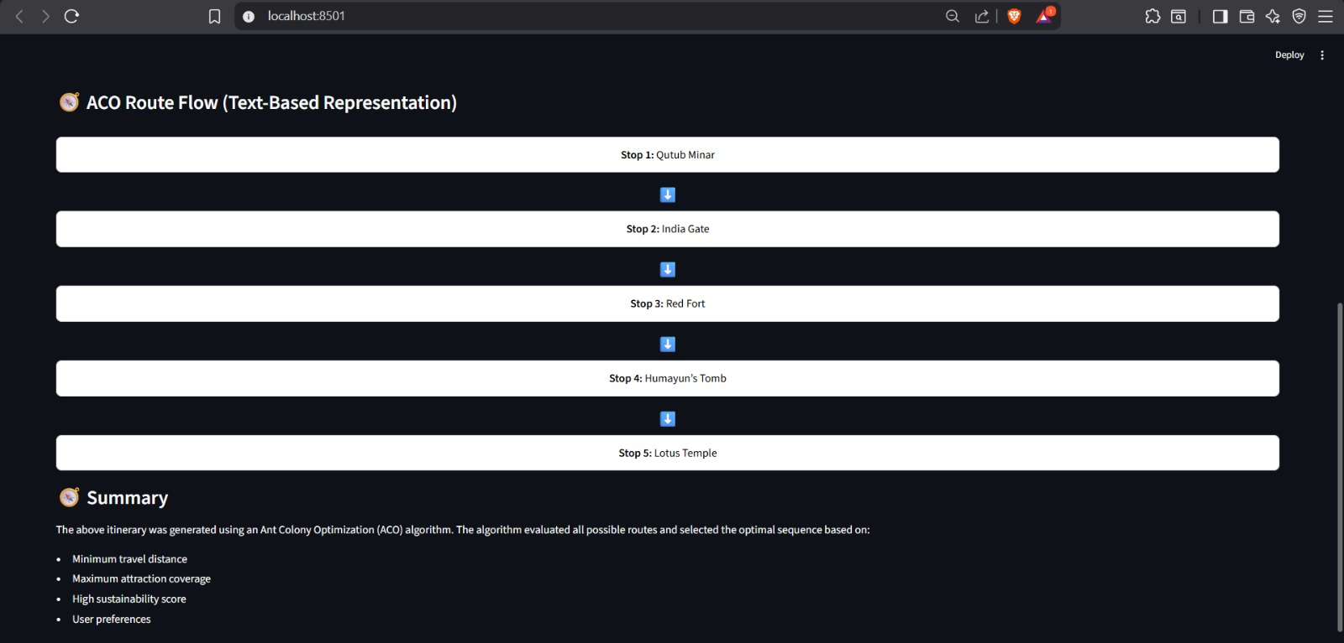
24

Slide 25

25

Slide 26
REFERENCES:
26
[1] Poonkuzhali, S., Archana Sangeetha J, Prem Anand, T.P (2023). Metaverse 3C: Concept, Components, and Challenges in Travel and Tourism Sector. In:
Rajakumar, G., Du, KL., Rocha, Á. (eds) Intelligent Communication Technologies and Virtual Mobile Networks. ICICV 2023. Lecture Notes on Data Engineering
and Communications Technologies, vol 171. Springer, Singapore
[2] G.RatnaKanth and S.Poonkuzhali, “ Sentiment Classification of Indian Tourist Reviews Using Deep Learning Techniques” in the Journal of Environmental
Protection and Ecology – Vol 22. No 6.
[3] Ratnakanth, G., Poonkuzhali, S. (2023). Indian Tourist Recommendation System Using Collaborative Filtering and Deep Autoencoder. In: Kaiser, M.S., Xie, J.,
Rathore, V.S. (eds) Information and Communication Technology for Competitive Strategies (ICTCS 2021). Lecture Notes in Networks and Systems, vol 401.
Pp.341-356. Springer, Singapore.
[4] De Paola, A., Gaglio, S., Giammanco, A., Lo Re, G., & Morana, M. (2021). A multi‐agent system for itinerary suggestion in smart environments. CAAI
Transactions on Intelligence Technology, 6(4),
[5] Lin, M., & Schaposnik, L. P. (2025). A carbon aware ant colony system for the sustainable generalized traveling salesman problem. Scientific Reports, 15(1).
[6] Nguyen, L. V. (2024). OurSCARA: Awareness-Based Recommendation Services for Sustainable Tourism. World, 5(2).
[7] Wallinger, S., Grundner, L., Majic, I., & Lampoltshammer, T. J. (2023, January). Agent-based modelling for sustainable tourism. In ENTER22 e-Tourism
Conference (pp. 355-360).
[8] Halder, S., Lim, K. H., Chan, J., & Zhang, X. (2024). A survey on personalized itinerary recommendation: From optimisation to deep learning. Applied Soft
Computing.
[9] Banerjee, A., Satish, A., & Wörndl, W. Enhancing Tourism Recommender Systems for Sustainable City Trips Using Retrieval-Augmented Generation. arXiv
2024.
[10] Xiao, X., Li, C., Wang, X., & Zeng, A. (2025). Personalized tourism recommendation model based on temporal multilayer sequential neural network. Scientific
Reports, 15(1).

Slide 27

THANK YOU

